Slide 1

JavaScript

Slide 2
Content
BOM
Form validation with JavaScript

Slide 3
JavaScript Browser BOM
The Browser Object Model (BOM) allows JavaScript to "talk to" the browser.
There are no official standards for the Browser Object Model (BOM).
Since modern browsers have implemented (almost) the same methods and properties for JavaScript interactivity, it is often referred to, as methods and properties of the BOM.
https://www.youtube.com/watch?v=LRghBhLFFO0

Slide 4
BOM vs DOM
BOM: Browser Object Model
DOM: Document Object Model
Are they related?

Slide 5
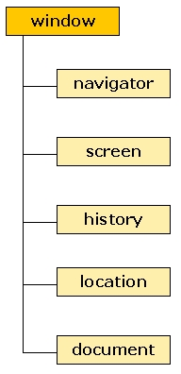
window is the top-level object in the BOM hierarchy
prompt(), and alert() are methods of the browser’s window object
You can call alert either with: window.alert(“Hello”);
Or just: alert(“Hello”);
window is a global object, which means you don’t need to use its name to access its properties and methods
Also: every global variable and function you define becomes part of the window object!
Notes:
Meaning of “every global variable and function you define becomes part of the window object!”
var a = 123;
console.log(window.a);
<!DOCTYPE html>
<html>
<head>
<title>Page Title</title>
<script src="script1.js"></script>
<script src="script2.js"></script>
</head>
<body>
<h1>This is a Heading</h1>
<p id="paragraph">This is a paragraph.</p>
<script src="script3.js"></script>
</body>
</html>
in script1.js file
var a = 123;
in script2.js file
var a = 456;
In script3.js file
console.log(window.a);
document.getElementById("paragraph").innerHTML=a;
Change var to let

Slide 6
Methods:
alert() – posts a message dialog
confirm("question") - returns true or false
prompt("question", "default") - returns a String
open() - open a new browser window
close() – close a window
Example:
https://www.w3schools.com/js/tryit.asp?filename=tryjs_screen_width
https://www.w3schools.com/jsref/tryit.asp?filename=tryjsref_state_switch4
Note: The window object contains many other methods and properties for various purposes – view them from within the browser debugger
Notes:
Change prompt to alert
Add window.alert()
Add window.open()
Window close example
https://www.w3schools.com/jsref/tryit.asp?filename=tryjsref_win_close

Slide 7
Other BOM objects are children of the window object
Note: This list is not complete
Represents information about the Browser and the underlying OS
Information about the display capabilities of the client PC running the Browser
Information on recently visited sites
Information on current URL
Represents the current web page – the DOM

Slide 8
Some navigator methods and attributes
Methods:
javaEnabled() – returns true or false
Geolocation – new HTML5
Properties (attributes)
appCodeName – code name of the browser
appName - name of the browser
appVersion- platform and version of browser
cookieEnabled – true if cookies are enabled
userAgent – user-agent header sent to server
An example:
https://www.w3schools.com/jsref/tryit.asp?filename=tryjsref_nav_geolocation
Notes:
navigator.appName;

Slide 9
Some screen methods and attributes
Properties (attributes)
availHeight, availWidth, height, width – metrics of display screen size
bufferDepth, colorDepth, pixelDepth – metrics of the color palette
deviceXDPI, deviceYDPI, logicalXDPI, logicalYDPI - number of dots per inch of the display screen
updateInterval – refresh interval
Example:
https://www.w3schools.com/js/tryit.asp?filename=tryjs_screen_height
https://www.w3schools.com/jsref/prop_screen_availheight.asp

Slide 10
Some history methods and attributes
Methods:
back() – loads the previous URL in the history list
forward() – loads the next URL in the history list
go() – loads specific page in the history list
Properties (attributes)
length – number of elements in the history list
Example:
https://www.w3schools.com/js/js_window_history.asp

Slide 11
Some location methods and attributes
Methods:
assign() – loads a new document
reload() – reloads the current document
replace() – Replaces the current document with a new one, and removes the URL of the current document from the document history
Properties (attributes)
host, hostname, href, pathname, port – hostname/port number/path/port/URL information
protocol – protocol of the current URL
hash, search – URL from the hash sign/question mark
Example:
https://www.w3schools.com/js/tryit.asp?filename=tryjs_loc_href
https://www.w3schools.com/js/tryit.asp?filename=tryjs_loc_assign
Notes:
window.location.host
window.location.pathname
window.location.protocol;

Slide 12
Form Validation

Slide 13
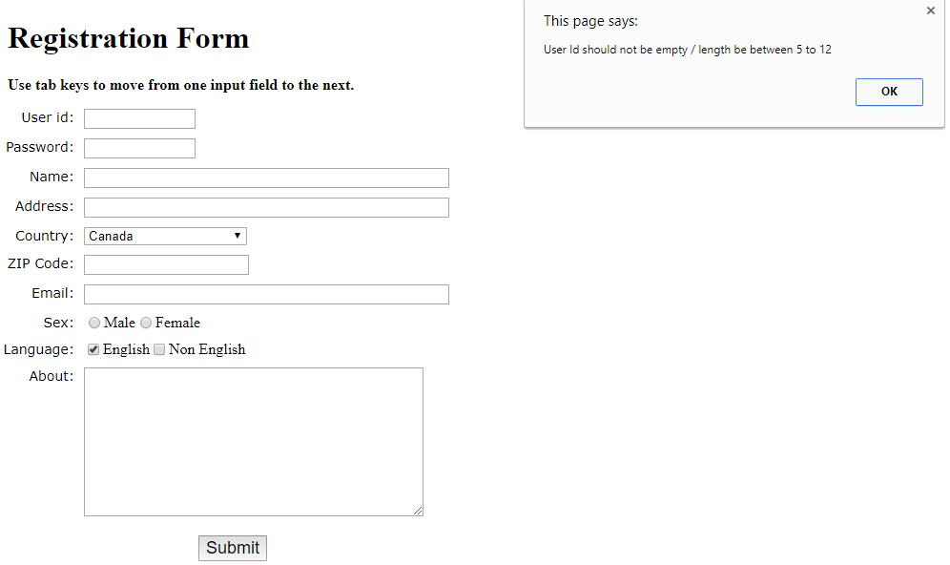
Validation

Slide 14
Try 1: show an error message with alert()
function idValidate(userId,mi,mx)
{
var userId_len = userId.value.length;
if (userId_len == 0 || userId_len <= mi || userId_len > mx)
{
errorMessage = "User id should not be empty or the length should be between "+mi+" to "+mx;
alert(errorMessage);
userId.focus();
return false;
}
return true;
}
function formValidate()
{
var userId = document.registration.userid;
//try var uid = document.getElementsByName("userid")[0]; var errorMessage ="";
let idValidation = idValidate(userId,5,12);
}

Slide 15
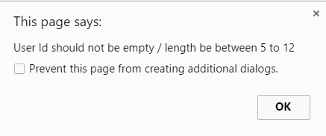
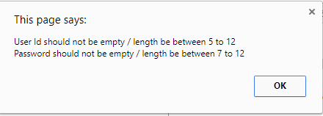
Try 2: Show all invalid messages at the same time
errorMessage +="\n" + "Password should not be empty or the length should be between "+mx+" to "+my;
New line
Notes:
var userPassword = document.registration.userpassword;
let passwordValidation = passwordValidate(userPassword,7,12);
function passwordValidate(userPassword,mx,my)
{
var password_len = userPassword.value.length;
if (password_len == 0 ||password_len >= my || password_len < mx)
{
errorMessage +="\n" + "Password should not be empty or the length should be between "+mx+" to "+my;
alert(errorMessage);
userPassword.focus();
return false;
}
return true;
}

Slide 16
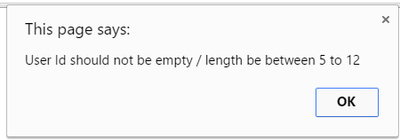
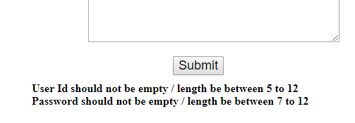
Try 3: Show a paragraph rather than pop up message
errorMessage += "<br>"+ "Password should not be empty / length be between "+mx+" to "+my;
document.getElementById("error").innerHTML=errorMessage;
New line
Notes:
Add the following, otherwise, the form will be submitted and the message will flash. Won’t stay on the screen.
if (idValidation&&passwordValidation)
return true;
else
return false;

Slide 17

Try 4: add 'required field' asterisk to form inputs
label.required:before{
content:"* ";
color:red;
}

Slide 18
Try 5: When the input is invalid show an arrow
When the input is valid show an check mark
<input type="text" name="email" size="50"/></li>
<input type="email" name="email" size="50" required/></li>
input:focus:invalid {
/* insert your own styles for invalid form input */
background-image: url("images/invalid.png");
background-position: right;
background-repeat: no-repeat;
}
input:focus:valid {
background-image: url("images/valid.png");
background-position: right;
background-repeat: no-repeat;
}

Slide 19




Try 6:
Use pattern to make sure password has at least 6 characters
Zip code has 5 numbers
pattern=".{6,} "
<input type="text" name="userid" size="12" required pattern=".{6,}"/></li>
<input type="text" name="zip" required pattern="[0-9]{5}" /></li>
https://www.w3schools.com/jsref/jsref_obj_regexp.asp

Slide 20
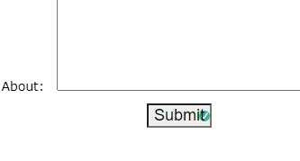
Fields not required are also marked with the small icon. How to solve?
Notes:
Add a new class to the required input field
input:focus:invalid.requiredinput {
/* insert your own styles for invalid form input */
background-image: url("images/invalid.png");
background-position: right;
background-repeat: no-repeat;
}
input:focus:valid.requiredinput {
background-image: url("images/valid.png");
background-position: right;
background-repeat: no-repeat;
}

Slide 21
How to make sure zip code has only numbers in JavaScript?
Notes:
var userZip = document.registration.zip;
Let zipValidation = zipValidate (userZip);
function zipValidate(userZip)
{
var numbers = /^[0-9]+$/;
if(userZip.value.match(numbers))
{
return true;
}
else
{
alert('ZIP code must have numeric characters only');
userZip.focus();
return false;
}
}

Slide 22
Before next class
Please continue to read w3school tutorial on JavaScript
In-class practice 2 due in two days

